Slide 1
Twitter Sentiment Analysis Tool
Project by Team 5:
Karim Elagamy, Shaun Mathes, Cory VanCura,
Wade Johnson, and Thomas Jess

Slide 2
Overview
During this presentation, we will be talking about our Twitter Sentiment Analysis tool, breaking down the project’s progress since the midterm presentation. We have previously talked about:
Functionality
Purpose & Demand
Monetization model
Where we aim to get with this project
Now we will go over how this project went and our final product. We will also be demonstrating the functionality we have achieved, demonstrating the vast improvements we’ve made in terms of performance, usability, as well as accuracy.

Slide 3
Scope of the Project
The aim of the project is to develop a fully functional sentiment analysis tool, which will be able to process tweets from the social media website Twitter and return to the user a sentiment analysis score indicating the positivity or negativity of each tweet as well as the overall sentimentality score of the entire dataset.
The application’s main two objectives are performance as well as accuracy, in order to ensure users can process as many tweets as possible with the highest level of accuracy possible to receive reliable results. We were hoping to achieve this with a minimum accuracy of 80% in the beginning, however we currently are at a rate of 86% accuracy according to our testing. We will be working to improve this further as we go along.

Slide 4
What is new (if the project is a carryover)
This project is a carryover of Karim’s final project for the class CSC-530, Information storage and retrieval. Originally the application needed the user to enter each tweet independently, and each tweet was processed individually until the user indicated they are done with their input then the overall result of the dataset was outputted.
Now, the user has the ability to enter the tweets as a dataset, providing the application with a csv file containing all the tweets they would like analyzed, and then the result is outputted after processing is complete. This allows the user to analyze hundreds or thousands of tweets at a time, instead of having to enter them one by one. We have also developed a separate auxiliary tool written in Python to create these dataset files, prompting the user to enter the hashtag they would like to analyze and then specify the amount of tweets they would like downloaded. The application then writes these to a csv file, formatted in a compatible way with the analysis tool. We have also improved the accuracy of the analysis tool considerably, by working on our lexicon. We spent time testing the project and adding slang terms, new vocabulary, and defining the Twitter emoticons in our lexicon so that we may factor them into our analysis. This way we can fully analyze a tweet to get a better understanding of its sentimentality, instead of just the words. We have also fixed a few bugs and errors we encountered, including an infinite loop in the analysis tool when a tweet longer than 256 characters was entered. This was due to the fact that Twitter recently raised the maximum character limit per tweet, and as such we must keep up with the platform to ensure the application runs smoothly.

Slide 5
Technologies to be used
The Hardware requirements for this project are: A working computer with a minimum of 4GB memory and at least an i3 or equivalent processor, with proper functionality and uninterrupted access to the internet.
As for the software requirements and technologies to be used in this project, we require only two. First of all the user must be running the application on a compatible operating system, which are: Windows 7 or later, Mac OS X 10.8 or later, or Linux within a compatible IDE. The other technology to be used in this project is the social media platform Twitter, which must be online and functioning in order for the auxiliary dataset creation tool to grab the tweets and format them in the csv file.

Slide 6
Reflection
We encountered several setbacks with this project, dealing with all the data management, the accuracy, and updating the lexicon. However, the most difficult part by far was creating the user interface for the application. None of us had previous experience creating C++ applications with user interfaces before, so it was really challenging trying to figure out how to build something around the already existing application that we carried over from Karim’s previous class. On top of that, our auxiliary tool, the Tweet Grabber, is also written in Python, so we had to figure out how to build an interface that could connect a python script and a C++ application.
What we would do differently in the future would probably be to program everything from scratch in the same language, as the C++ application could have possibly been rewritten in Python if we had more time. This, coupled with some good planning from the beginning, would have probably made the UI creation process much easier to accomplish.

Slide 7
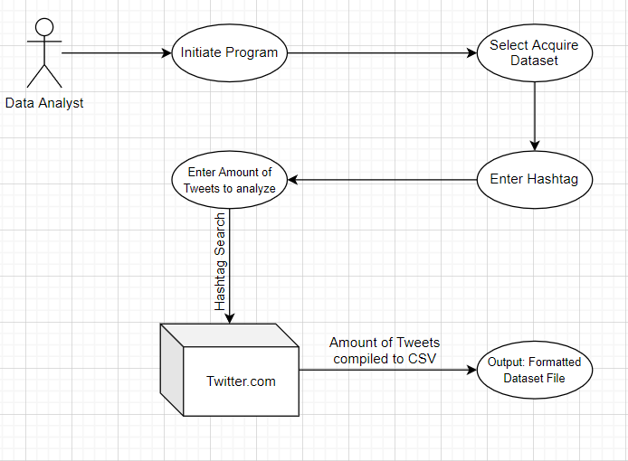
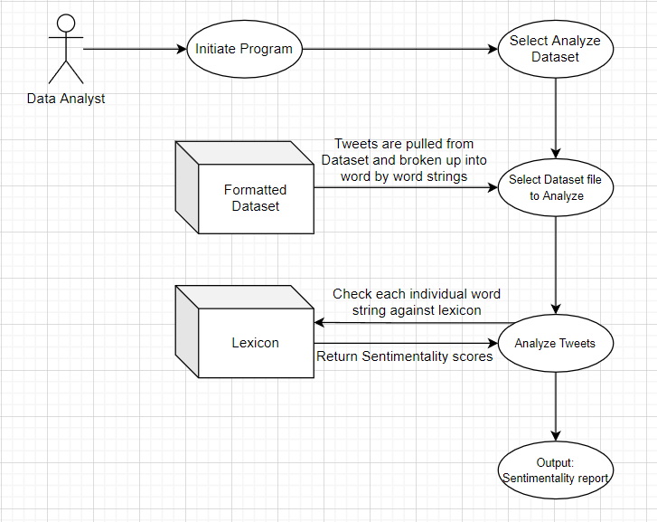
Relevant Use Cases

Slide 8
Text Use Case
Use Case: analyzeDataset
Primary Actor: Data Analyst or Experienced End User
Secondary Actor(s):
Twitter.com
AFINN Sentiment Lexicon
Actor’s Goals:
Analyze a dataset acquired previously to obtain a sentimentality rating on the overall positivity or negativity of the dataset. The output he is hoping for is a statistical breakdown of how many of the tweets in the sample dataset were positive, negative, and the overall rating of the dataset. This output may be saved to a text file detailing the breakdown of each individual tweet if the user chooses to.
Preconditions:
Internet access required.
Main tasks / functions to be performed by the actor:
Select the dataset which will be analyzed for its sentiment.
Save the output file in a location of their choosing.
Exceptions to be considered:
Slang and informal text caused false positives or negatives.
Accounting for bot-based content which may skew the analytics.
Outliers caused by a popular or public event.
Possible variations in the actor’s interaction:
Badly or improperly formatted datasets which may cause analytical errors.
Selective or biased dataset selection which may cause inaccurate conclusions.
System information that the actor will acquire, produce, or change:
Actor will acquire a detailed output of the sentimentality rating of the Twitter dataset selected, as well as a text file containing the analysis report if they choose to save it.
Will the actor have to inform the system about changes in the external environment:
No.
What information does the actor desire from the system:
A sentiment analysis of the tweets contained within the dataset they have selected, with a detailed output describing the statistics of the dataset’s positivity and negativity.
Does the actor wish to be informed about unexpected changes:
Yes
Scenario:
User launches the application, and is prompted to select whether they would like to acquire a dataset or analyze a dataset.
User selects that they would like to analyze a dataset, and then they are prompted to select a dataset.
The user inputs the selected dataset file name.
The application begins processing the dataset, informing the user of its progress as it goes through the dataset.
The user is notified when the application is done processing the dataset and a detailed report is outputted to the user.
User is then prompted if they would like to save the output to a text file.
User selects whether they would like to save the report or not, then the application is terminated.
Frequency of use: As needed
Channel to actor:
Computer
Monitor
Keyboard

Slide 9
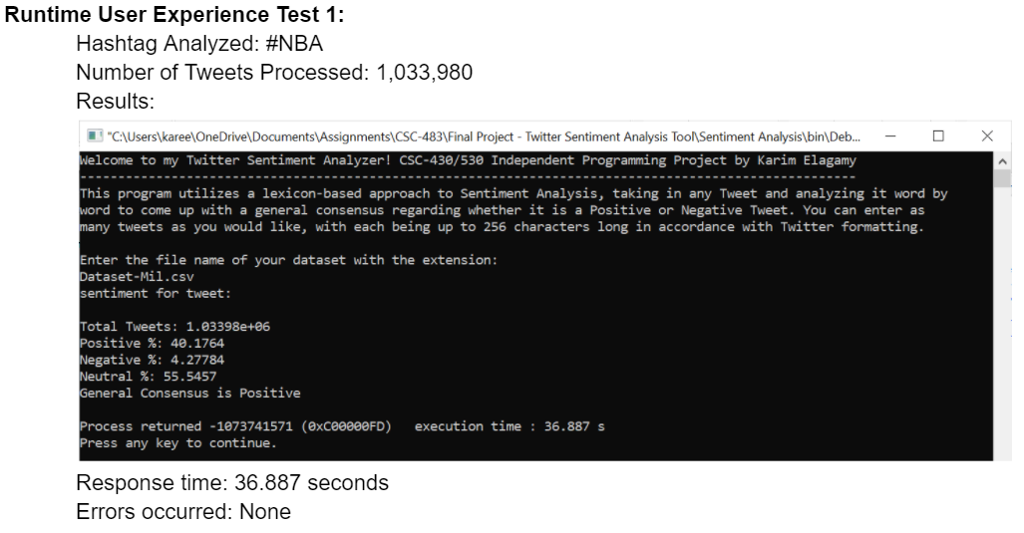
Test Case
Here is our test case that we ran for our project to test its performance:

Slide 10
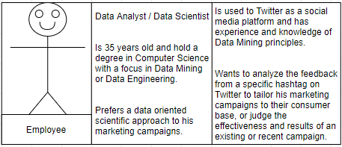
Personas
This product is pretty specialized, and as such our target audience is specifically Data Analysts and Data Scientists. Here is our persona that we created for this project:

Slide 11
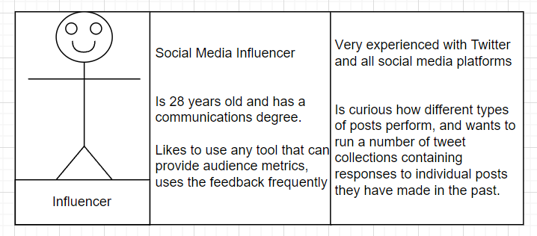
Personas
We also came up with a couple of possible non corporate client personas, such as the:

Slide 12
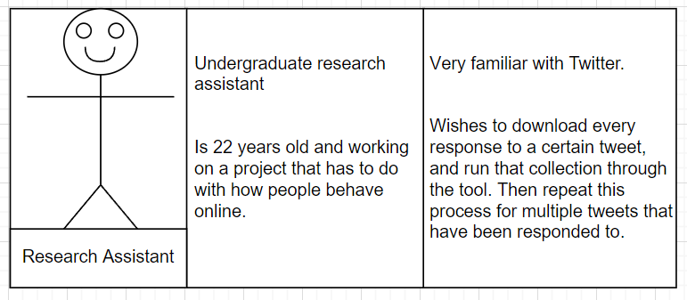
Personas
And the:

Slide 13
Monetization model
The monetization model for this software is going to be a software licensing model, as companies and corporations pay for a product license so that our software can be available for their employees to use. This license would be renewed annually, from the date the license was purchased by the company. In a hypothetical situation where we are a software company licensing out this software to other companies and corporations, this would allow for us to have a continued income from this product, and as such allow us to hire developers to provide constant updates and releases to fix any bugs or issues, improve accuracy, and cater to our clients’ needs.

Slide 14
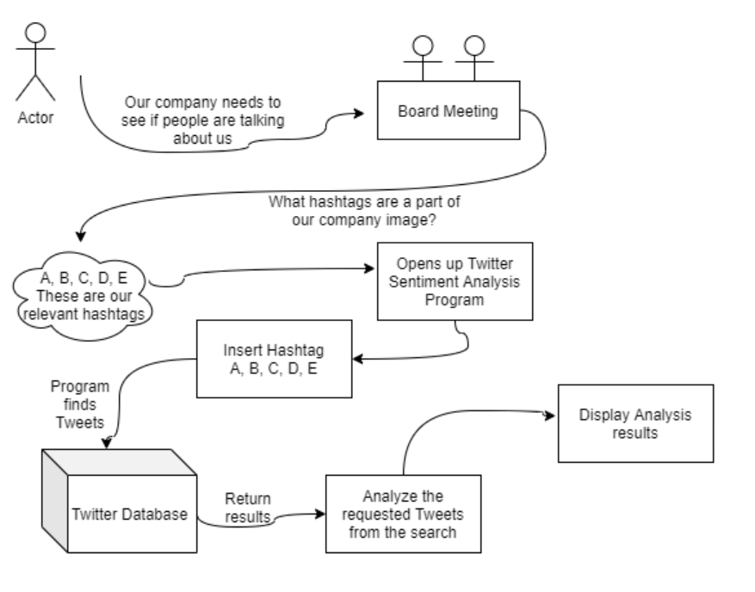
Prototype
Here is our storyboard for our application prototype: -->
We will also be demonstrating the functionality of our final prototype later on during the presentation.

Slide 15
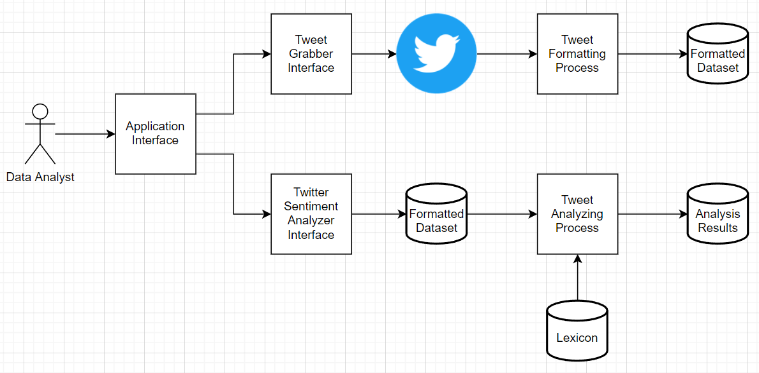
Architecture
Here is our Architecture diagram for our Twitter Sentiment Analysis Tool and our Auxiliary Tweet Grabber Tool:

Slide 16
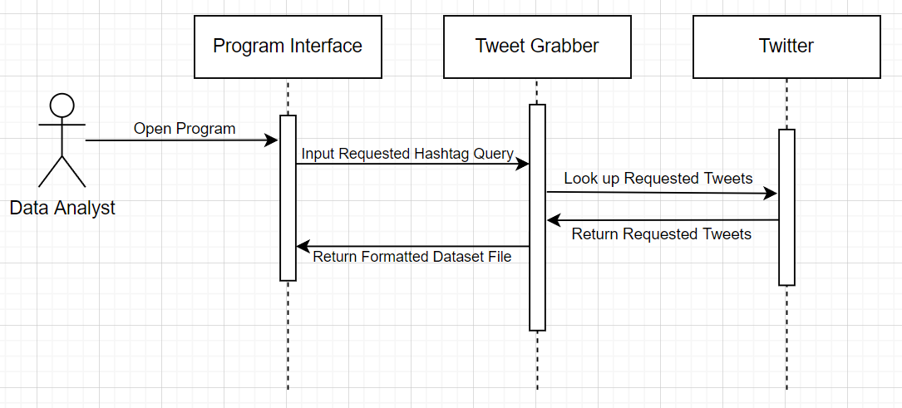
Sequence Diagram 1

Slide 17
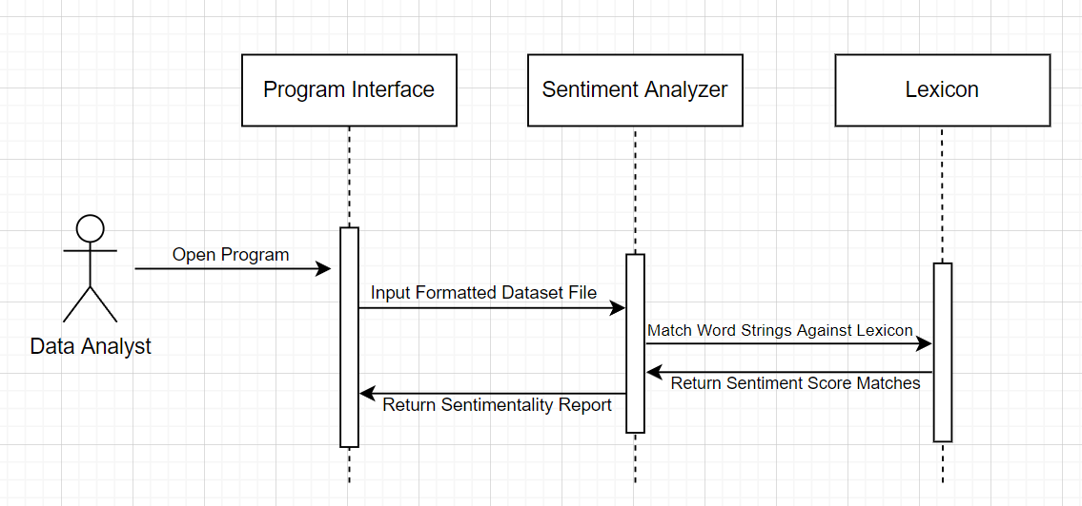
Sequence Diagram 2

Slide 18
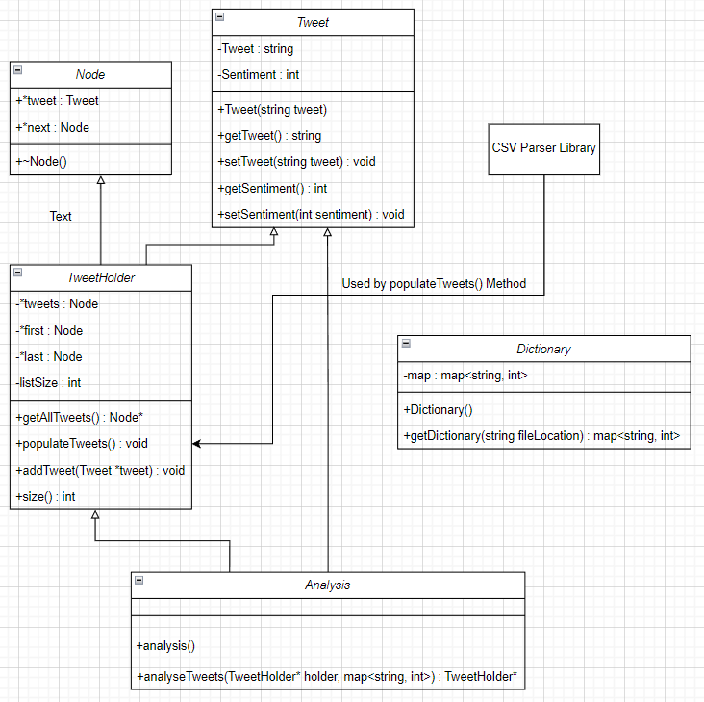
Class Diagram
Here is our class diagram for our most complicated subsystem, the actual Twitter Sentimentality Analysis tool:

Slide 19
Demonstration
Now we will demonstrate our Project

Slide 20
Q & A
Any questions from the audience?

